Slide 1
Syntax Analyzer
103_Spring_Compiler Construction

Slide 2
Homework 2
Target: Compiler for C , C++
Deadline: 5/7(四) 23:59
DEMO: 5/8(五)(下午上課時間至晚上)
Upload your file to moodle
A zipped file(.rar, .zip, .7z, …) contain your source code and readme
Filename: StudentID
Ex: F74001234.rar
Post your problems on moodle

Slide 3
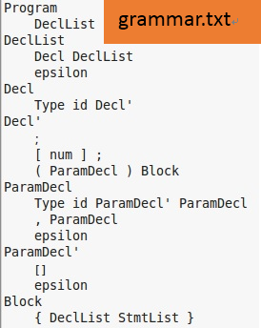
Input file:
main.c
grammar.txt
Output file:
set.txt
LLtable.txt
tree.txt
Program -> VarDeclList | FunDeclList
VarDeclList -> VarDecl VarDeclList | ε
…
Environment: Linux: g++ 4.8.2版
不允許使用3rd-party函式庫，必須使用C/C++(包含C++11)
Set.txt 25%
LLtable.txt 25%
Tree.txt 25%
解釋程式碼 25%

Slide 4
Syntax Analyzer
Grammar
Parser Generator
Parse Table
Parser
Token
List
First
Follow
Parse Table
Parse
Tree

Slide 5
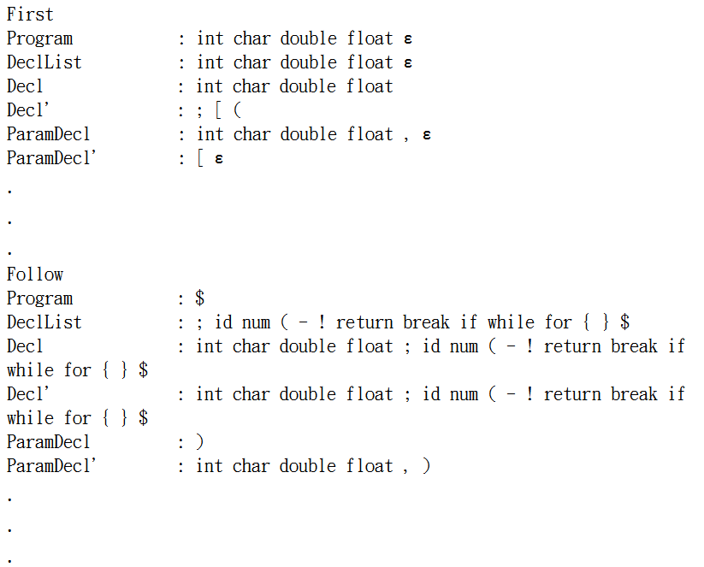
Parser Output Example 1
Grammar
set.txt
Display all nonterminal
First
Follow
in set.txt
Format - symbol : value
First & Follow：Separate every symbol with space

Slide 6
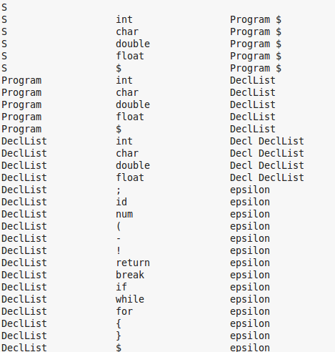
Parser Output Example 2
your start symbol
print your start symbol in first line.
print
nonterminal
terminal
prdouction body
in a line
LLtable.txt
production body
nonterminal
terminal

Slide 7
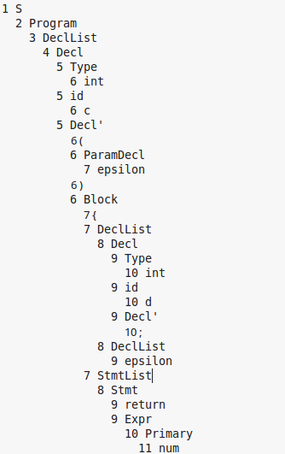
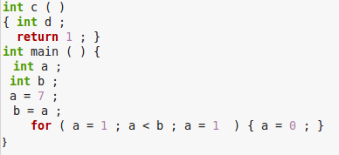
Parser Output Example 3
tree.txt
ID、Num、Char display value
Display parse tree

